Slide 1
Lucy Dinkinesh Peer Review: Lucy L'TES
Timothy N. Titus
12:00 EDT

Slide 2
Overview
Methodology
Documentation
Data
  Raw Housekeeping Data
  Raw (Engineering) Data
  Calibrated Data
Summary
References
Figure 2-3 Calibration Processing Pipeline

Slide 3
Methodology
Software Tools
Approach
Windows OS platform
PDS4_Viewer
My own IDL v8.9 code.
In cases where the IDL could not be read, I used the PDS4_Viewer to export the needed values to CSV files, which could then be read into IDL.
Conducted manual cross-referencing checks between labels and values form the PDS4_Viewer and IDL results using pds_read.pro.
My replication of the calibration pipeline, based on the documentation, was conducted in IDL.
Compared calibrated results to published analysis.

Slide 4
Documentation
Figure 2-3 provides a good overview of the calibration pipeline processing steps.
  I believe that this figure will be helpful to those not familiar with calibrating thermal interferometry data.
Table 2-3 is key to doing the calibration.
  The table looks good. The values appear unchanged from other TES family of instruments (e.g., OTES), which is not surprising.
Table 3-2, LTES Uncalibrated Data Product, has issues.
  The arrays in this table do not align with the actual data. For example, the table has sclk either located in at array index number 54 for hkraw or at 56 for raw. But the actual data files have sclk as the first data array. The table order appears to have been alphabetized by array name, as opposed to data order within structure. The data appears to be organized in a practical order. (See next slide)
  The documentation table should be adjusted to reflect this order or update the Array Index Number.
Table 3-4, Calibrated Science Format, looks good and is very useful and informative.

Slide 5
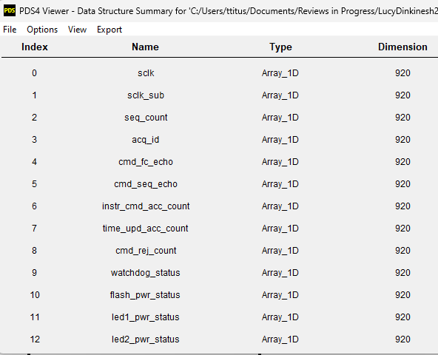
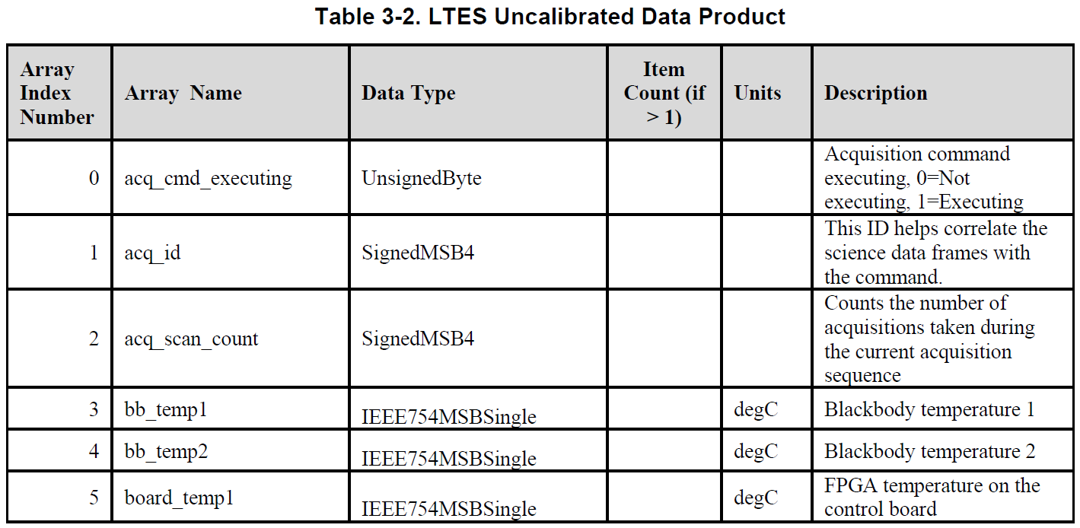
Data: Housekeeping & Engineering
PDS4 Viewer: tes_0752128689_02105_eng_03
LTES_SIS Table 3-2
  The current data format appears to be organized in a practical/pragmatic order.
  The documentation table should be adjusted to reflect this order or update the Array Index Number.

Slide 6
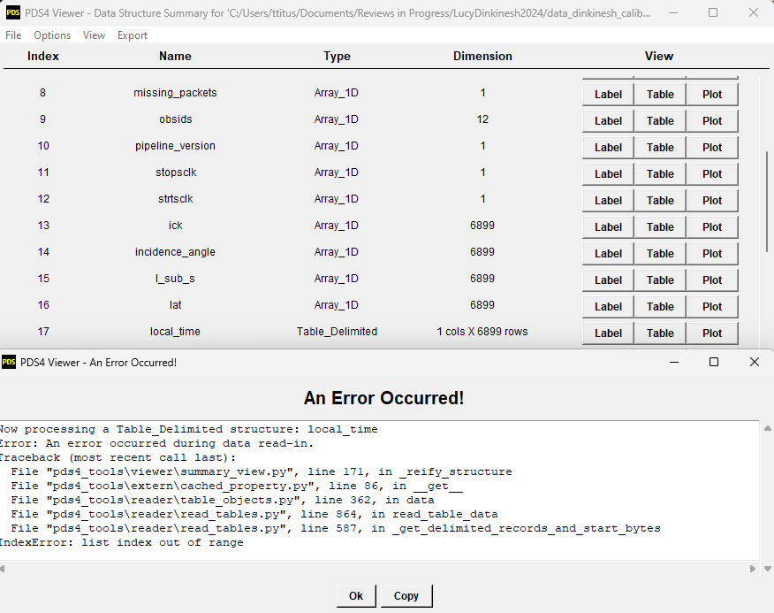
Data: Calibration
Science data file corrupted
IDL was unable to read the science data file.
  Attempts to use IDL pds_read.pro resulted in a “End of file encountered” error suggesting there is missing data somewhere in the file.
The PDS4_VIEWER was able to read and export all data arrays that I tried except the local_time array.
  Local_time array was not crucial to my review and analysis, but I suspect this is where the file corruption had occurred that prevented IDL from reading the entire file.
This should be investigated and corrected.
  Once the calibrated data file error has been fixed, the file should be reviewed to validate the data formats.

Slide 7
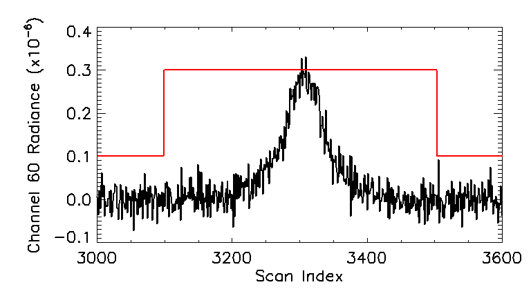
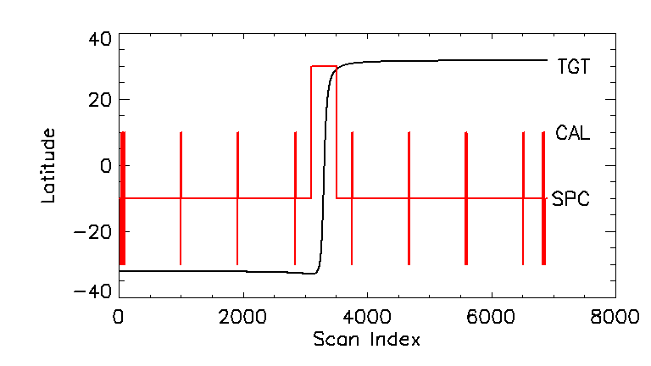
Calibrated Data File: Target Type
Channel 60 radiance vs. scan index. The black line is the channel 60 radiance. The red line is the observation type.
Latitude vs. scan index. The black line is sub-spacecraft latitude. The red line indicates the type of observation.
Obs Type
3
2
1
0
Type=0 is not described in the SIS.

Slide 8
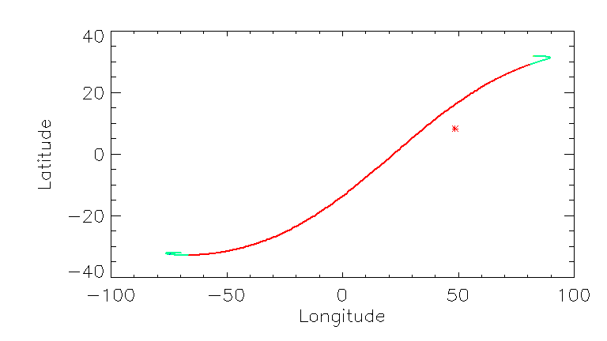
Geometry
Sub-Spacecraft Latitude vs. Longitude.
The line indicates the sub-spacecraft location on Dinkinesh. When the line is red, the observation is target where green indicates space looks. The red asterisk indicates the subsolar point.
Parameters:
Emission Angle: 9999
Incidence Angle: 9999
Lat: 9999
Lon: 9999
Phase Angle: 9999
Sub_SC_Lat: Valid
Sub_SC_Lon: Valid
Sub_Sol_Lat: Valid
Sub_Sol_Lon: Valid
I like that geometry data is in the SCI file and not a separate GEO file.

Slide 9
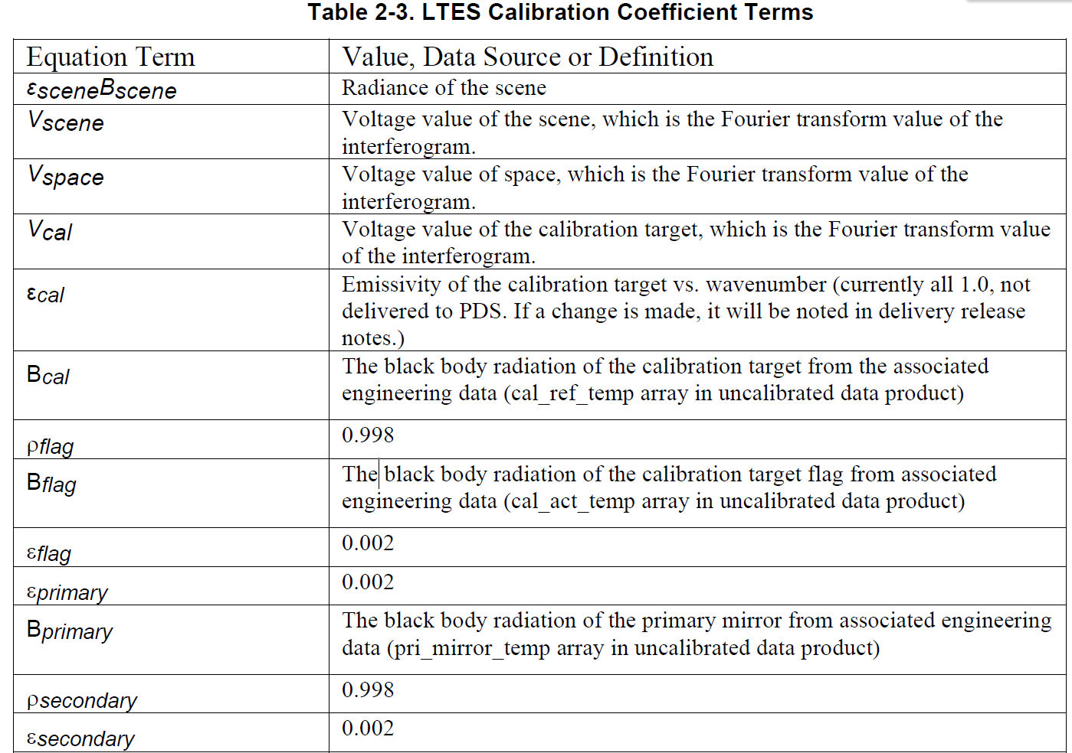
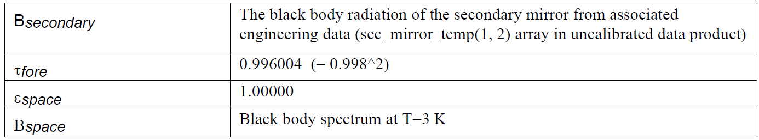
Calibration Pipeline
The LTES CDP module transforms each interferogram (ifgm array) into a voltage spectrum (vspec array). The transformation is done by performing a Discrete Fourier Transform (DFT) on the raw interferogram.

Slide 10
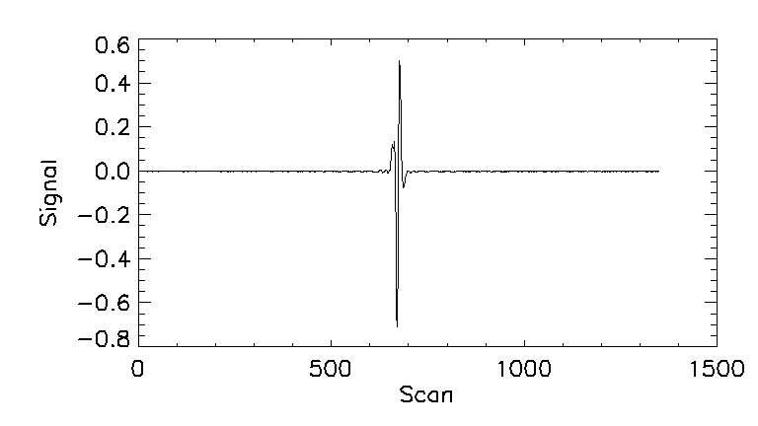
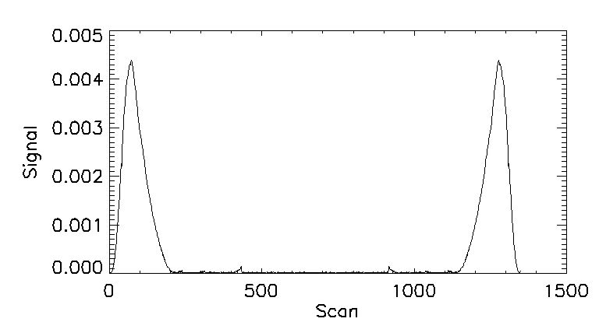
DFT Conversation of IFGM
IFGM
VSPEC (Absolute values; Not scaled)

Slide 11
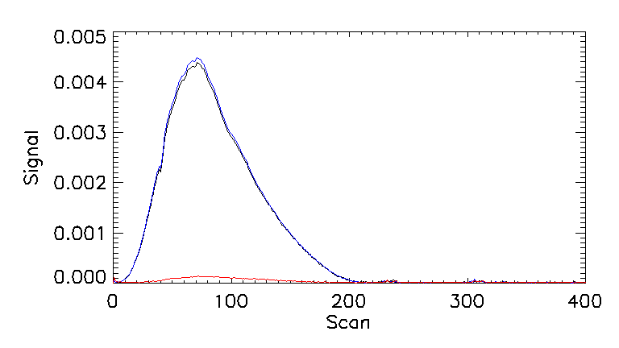
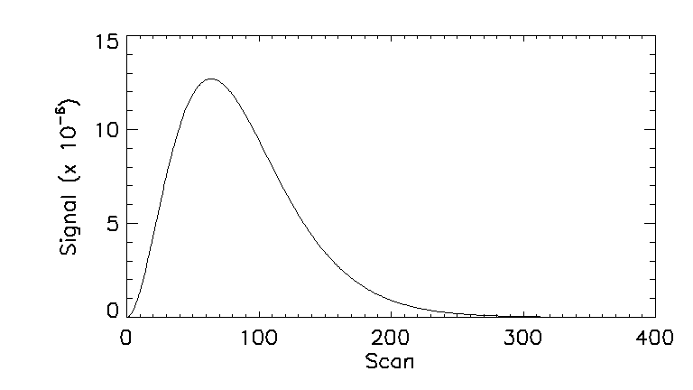
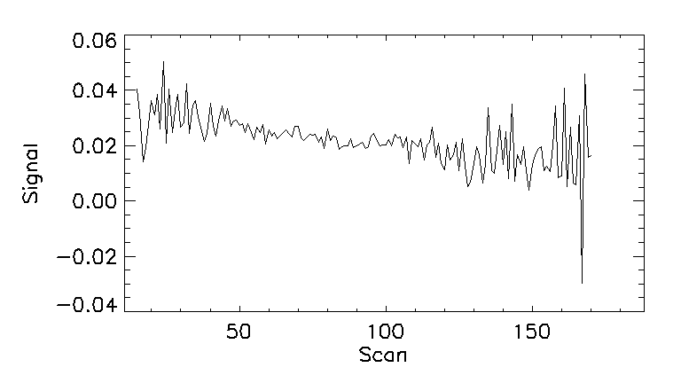
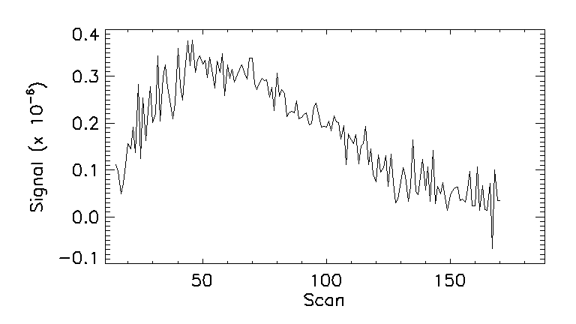
V_SPECS
Instrument Response Function (IRF)
Scene
Space
Calibration
Single Obs: Vspec Ratio
Calibrated Spectrum

Slide 12
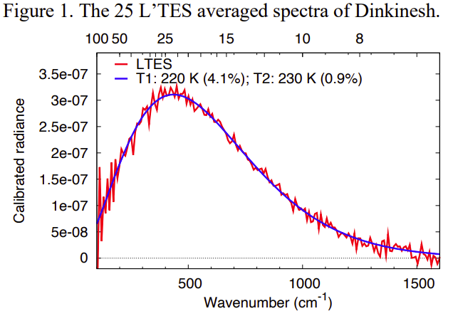
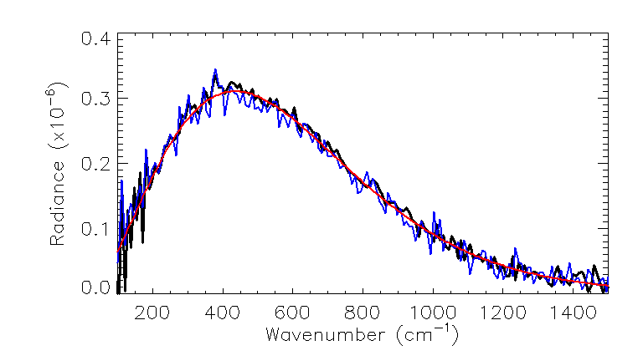
Calibration
Black = LTES Calibration
Blue = My Calibration
Red = 2-Temperature fit
Chistensen et al., 2024
I used the average of three calibrations looks, the average of five space looks, and the average of eleven target looks to generate my calibration curve.

Slide 13
Summary
Major
  Table 3-2 should reflect the order of the data as it appears in the data files. Either reorder list or update Array Index Numbers.
  The Science data file should be fixed so that all of the data can be accessed.
Minor
  Observation type =0 was never identified as to what LTES was observing. Types 1-3 were identified as space, calibration, and target, respectively.

Slide 14
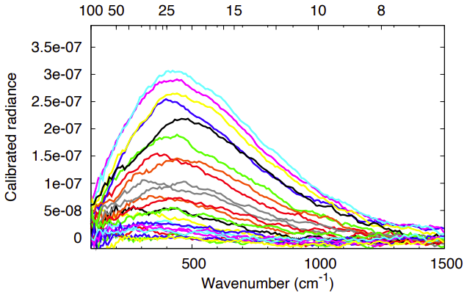
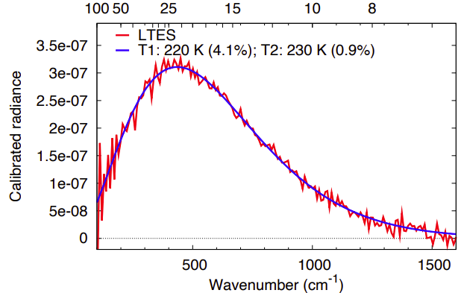
References
Christensen et al., 2024, Lucy Thermal Emission Spectrometer (L'TES) Temperature Observations of Dinkinesh, 55th LPSC, held 11-15 March, 2024 at The Woodlands, Texas/Virtual. LPI Contribution No. 3040, id.1384

